Slide 1
The Implementation
ER system introduction & issues

Slide 2
ER information system introduction
Brain storm & hope on the horizon
Initializing with the psychologic poll
Emotion indicators v1.0
Emotion indicators v2.0
Applying ranking theory

Slide 3
ER information system introduction
Brain storm & hope on the horizon
Emotion status can be break down into indicators
That's how we react to incidents & environment
What's important can be polled
(according to the psychology teacher)

Slide 4
ER information system introduction
Initializing with the psychologic poll

Slide 5
ER information system introduction
Initializing with the psychologic poll
Top 10
学习压力 / Academic Pressure | 14 |  | 追星/偶像 / Stars & Elites | 7
父母/家庭关系 / Parents, Family Relations | 10 |  | 学业 / Academic Performance | 6
朋友/人际关系 / Firends & Personal Relations | 10 |  | 天气 / Wheather | 5
考试测试 / Tests & Exams | 8 |  | 周边环境 / Physical Environment | 4
恋爱/异性 / Love | 7 |  | 托福成绩 / TOEFL Scores | 4

Slide 6
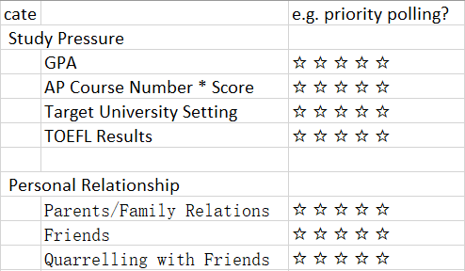
ER information system introduction
Emotion indicators v1.0
the first intuitive thinking

Slide 7
ER information system introduction
Emotion indicators v1.0
tried a flexible design
Video A: the indicator design pattern

Slide 8
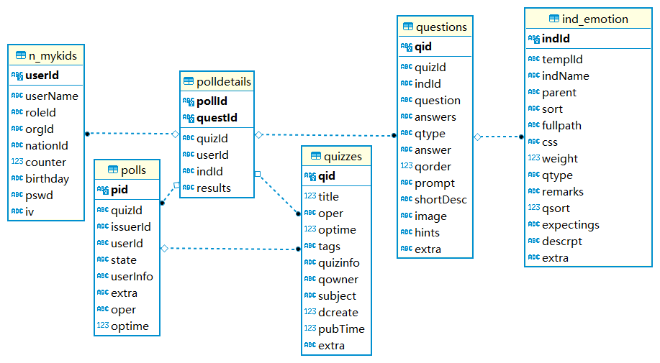
ER information system introduction
Questions
The indicators’ instance
Emotion Index
Poll Subjects
Detailed Answers
The users’ response
Polls
The poll events
Quiz
The combine of questions

Slide 9
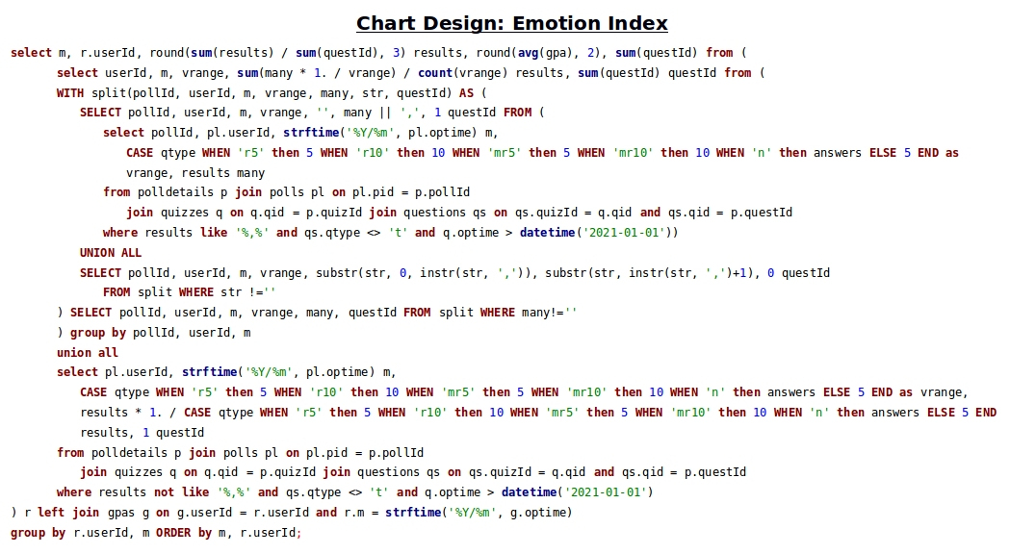

Slide 10
ER information system introduction
Emotion indicators v1.0
so we need a flexible design
Video B: the poll & quiz calculation

Slide 11
ER information system introduction
Emotion indicators v1.0
Results: extremely not user friendly
Too much questions in one quiz
Questions are hardly answerable

Slide 12
ER information system introduction
Emotion indicators v1.0
Results: extremely not user friendly
Too much questions in one quiz
Questions are hardly answerable

Slide 13
ER information system introduction
Emotion indicators v2.0
Changes:
Add & divide the questions into multiple equivalent parts
Keep each quiz has only 8 – 9 questions
Simplify the question types to 1 type: 5 star ranking

Slide 14
ER information system introduction
Emotion indicators v2.0
Changes:
Add & divide the questions into multiple equivalent parts
Keep each quiz has only 8 – 9 questions
Simplify the question types to 1 type: 5 star ranking

Slide 15
ER information system introduction
Emotion indicators v2.0
Changes:
Divide the questions into multiple equivalent parts
Keep each quiz has only 8 – 9 questions
Simplify the question types to 1 type: 5 star ranking

Slide 16
ER information system introduction
Applying ranking theory
TODO …

Slide 17
Issues
Data, team, knowledge and more …

Slide 18
Why failed?
A user friendly application is much more expensive than expected
Timeline & the process disappointed everyone
…

Slide 19
Why failed?
The most important:
I need a solid understanding of emotion!

Slide 20
Guessing the future direction
Is knowledge acquire / cognition the answer?
e.g. like what Stoicism tells us:
What happens in the real world can not be controlled,
but what we feel is controllable.

Slide 21
Guessing the future direction
Or supervised learning?
An easy step to adapt to supervised learning process:
Have the users themselves rank their emotions.
Multiple Regression Model

Slide 22
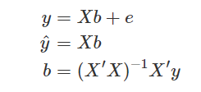
Guessing the future direction
Have the users themselves rank their emotions ( y ).
Multiple Regression Model
where
y = n x 1 column of different emotions labeled by users themselves
ŷ = n x 1 column of predicated y
X = n x k matrix of question weights
b = k x 1 column vector or regression coefficients
e = n x 1 column vector of n residual values

